Slide 1


Slide 2

Decreased fetal movement
Dr.ladan Ajori
Shohadaye Tajrish Hospital

Slide 3
Normal fetal movement
Fetal movement can be assessed using various methods of fetal kick counting
but this form of fetal surveillance has not achieved widespread acceptance.

Slide 4
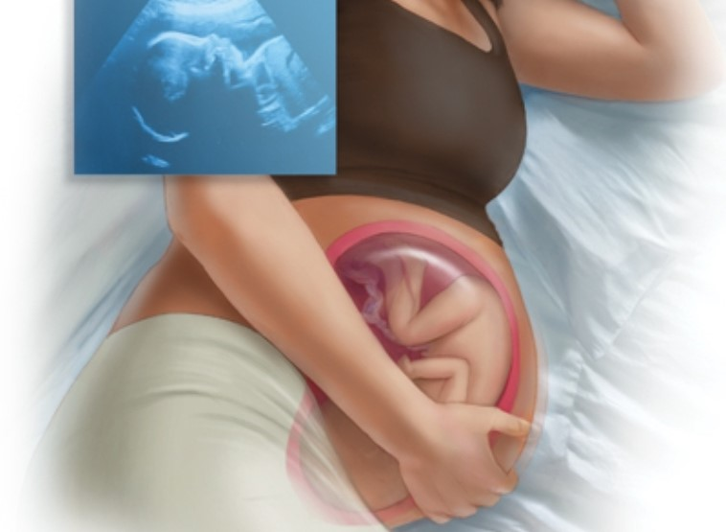
NORMAL FETAL MOVEMENT
— Sonographically 7-8weeks
--Maternal perception 16-20 weeks
When sonographically detected movements were correlated with maternal perception, approximately 50 percent of isolated limb movements were perceived by the mother,

Slide 5
PREVALENCE OF DECREASED FETAL MOVEMENT
At least 40 percent of pregnant women become concerned about DFM one or more times during pregnancy, but most episodes are transient
4 to 15 percent of pregnant women will contact their care provider because of persistent DFM in the third trimester

Slide 6
PATHOPHYSIOLOGY
— A normal quantity and quality of fetal movement virtually ensures functional integrity of fetal regulatory systems.
When these regulatory systems are subjected to mild hypoxemia, DFM is believed to represent a compensatory fetal behavioral response, analogous to the compensatory physiological response of redistribution of blood flow to essential organs.
As hypoxemia becomes more severe and prolonged, compensatory responses may fail to protect the fetus, eventually leading to organ damage or death.

Slide 7
DIAGNOSIS OF DECREASED FETAL MOVEMENT
give all pregnant women verbal and written information on normal fetal movements across gestation and normal wake/sleep cycles.
At each clinical visit, we emphasize the importance of maternal awareness of fetal movements
counsel women that they should contact their health care provider immediately if they perceive DFM from baseline

Slide 8
best diagnostic criteria are controversial
Perception of least 10 fetal movements (FMs) over up to two hours when the mother is at rest and focused on counting ("count to 10" method).
Perception of at least 10 FMs during 12 hours of normal maternal activity.
Perception of at least 4 FMs in one hour when the mother is at rest and focused on counting.
Perception of at least 10 FMs within 25 minutes in pregnancies 22 to 36 weeks and 35 minutes in pregnancies 37 or more weeks of gestation.

Slide 9
DIFFERENTIAL DIAGNOSIS
fetal sleep states,
maternal medications
Poor maternal perception of fetal activity
obesity has been reported to decrease maternal perception of fetal activity, a systematic review found that increased maternal body size was not associated with altered perception of fetal movement, but was associated with increased presentation for DFM [

Slide 10
EVALUATION
should be evaluated as soon as possible, preferably within two hours.
assessment of maternal, obstetric, and fetal risk factors for stillbirth
review of symphysis fundal height measurements and a nonstress test (NST) should be performed to exclude immediate fetal compromise IF it was normal should do sonography within 24 hours
If the clinical assessment (including NST and ultrasound) is normal and maternal concern of DFM persists, further management is individualized.

Slide 11


Slide 12
initial evaluation
Check fetal heart rate
Review prenatal record
Perform a NST

Slide 13
Additional testing
Ultrasound examination
Doppler velocimetry
Testing for fetomaternal bleeding

Slide 14
PREGNANCY MANAGEMENT
Nonreactive nonstress test, low biophysical profile score, fetal growth restriction
managed according to usual clinical standards

Slide 15
Return of normal fetal activity and normal evaluation
can resume routine prenatal care
continue to monitor fetal movement and call their provider if they perceive recurrent persistent DFM.

Slide 16
Persistent DFM and normal fetal evaluation
For women ≥39 weeks of gestation
Recommend delivery.
In low-risk nulliparous women, there are no substantial benefits, but potential harms, of expectant management beyond 39 weeks

Slide 17
Persistent DFM and normal fetal evaluation
For women <37 W
recommend nonstress testing and ultrasound examination twice weekly
instruct patients to call their provider if they perceive a further decrease or absence of fetal movement

Slide 18
Persistent DFM and normal fetal evaluation
For women ≥37 weeks and <39 w
increasing risk of sudden unexplained intrauterine death after 37 weeks.
Counseling women about monitoring fetal activity is problematic if they have poor perception of fetal movement.
We discuss the advantages and disadvantages and suggest induction, especially if there are additional risk factors for adverse outcome.

Slide 19
EFFICACY
Fetal movement counting has not been proven to reduce the risk of perinatal mortality.
DFM is commonly reported by women with healthy fetuses and fetal death is rare; therefore, the positive predictive value is extremely low.
It is also possible that more research is needed to determine effective management of these pregnancies.

Slide 20


